Slide 1
Publishing Android Application
Android application publishing is a process that makes your Android applications available to users.
It is the last phase of the Android application development process.
Once you developed and fully tested your Android Application, you can start selling or distributing free using Google Play (A famous Android marketplace). You can also release your applications by sending them directly to users or by letting users download them from your own website.

Slide 2
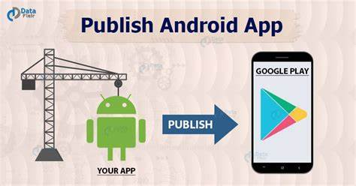
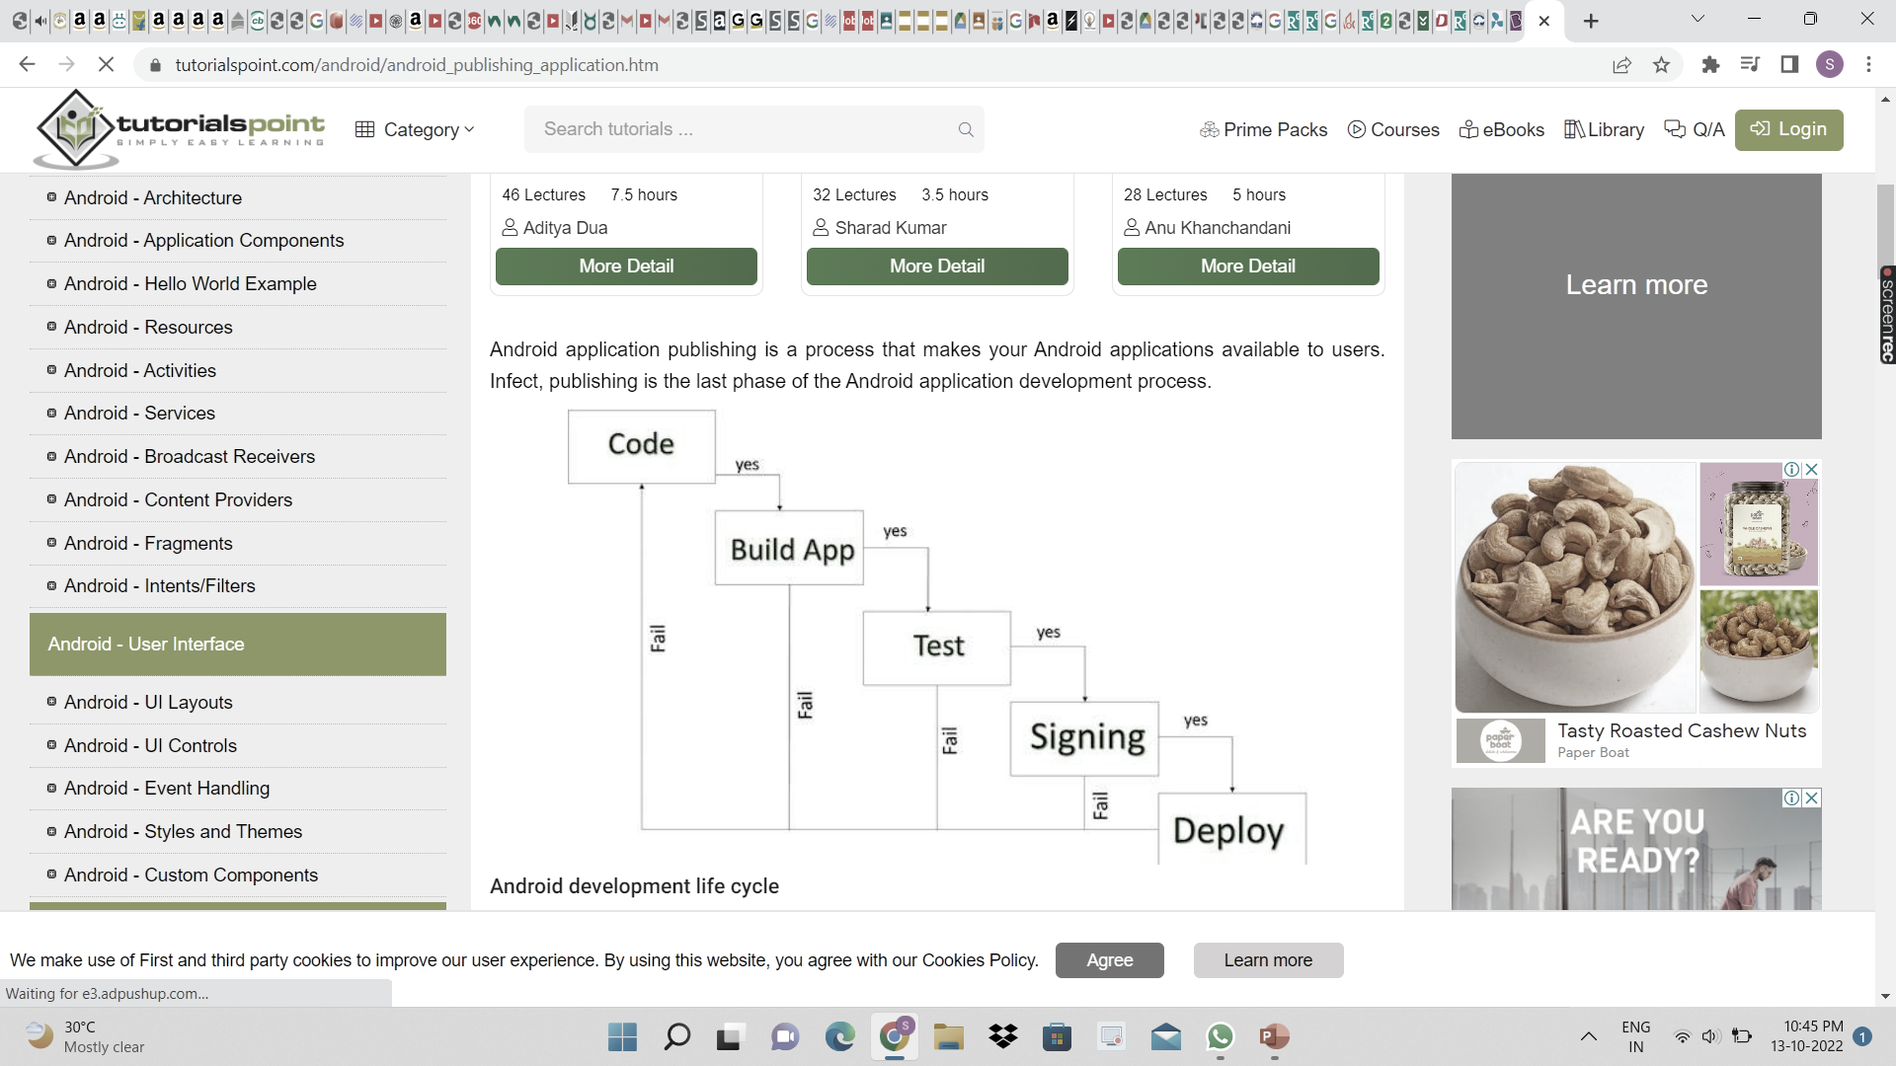

Slide 3
Step | Activity
1 | Regression Testing Before you publish your application, you need to make sure that its meeting the basic quality expectations for all Android apps, on all of the devices that you are targeting. So perform all the required testing on different devices including phone and tablets.
2 | Application Rating When you will publish your application at Google Play, you will have to specify a content rating for your app, which informs Google Play users of its maturity level. Currently available ratings are (a) Everyone (b) Low maturity (c) Medium maturity (d) High maturity.
3 | Targeted Regions Google Play lets you control what countries and territories where your application will be sold. Accordingly you must take care of setting up time zone, localization or any other specific requirement as per the targeted region.
4 | Application Size Currently, the maximum size for an APK published on Google Play is 50 MB. If your app exceeds that size, or if you want to offer a secondary download, you can use APK
5 | SDK and Screen Compatibility It is important to make sure that your app is designed to run properly on the Android platform versions and device screen sizes that you want to target.
6 | Application Pricing Deciding whether you app will be free or paid is important. If you want to sell your application then you will have to specify its price in different currencies.
7 | Build and Upload release-ready APK The release-ready APK is what you you will upload to the Developer Console and distribute to users. You can check complete detail on how to create a release-ready version of your app:
8 | Promotional Content It is a good marketing practice to supply a variety of high-quality graphic assets to showcase your app or brand. After you publish, these appear on your product details page, in store listings and search results, and elsewhere.
9 | Finalize Application Detail to promote your app and engage with users on your product details page, from colourful graphics, screen shots, and videos to localized descriptions,

Slide 4
Apk development process
Before exporting the apps, you must some of tools
Dx tools(Dalvik executable tools ): It going to convert .class file to .dex file. it has useful for memory optimization and reduce the boot-up speed time
AAPT(Android assistance packaging tool):it has useful to convert .Dex file to.Apk
APK(Android packaging kit): The final stage of deployment process is called as .apk.

Slide 5
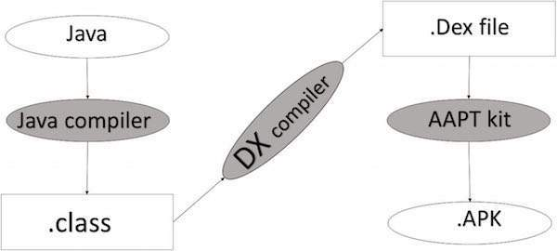
Conversion into final apk from android language

Slide 6
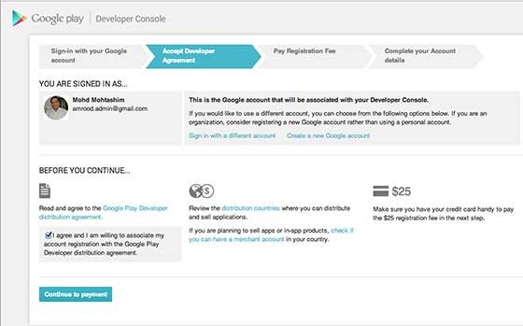
Google Play Registration The most important step is to register with Google Play using Google Play Marketplace. You can use your existing google ID if you have any otherwise you can create a new Google ID and then register.

Slide 7
Once you are a registered user at Google Play, you can upload release-ready APK for your application and finally you will complete application detail using application detail page
Releasing through a website
If you do not want to release your app on a marketplace like Google Play, you can make the app available for download on your own website or server, including on a private or enterprise server. To do this, you must first prepare your application for release in the normal way. Then all you need to do is host the release-ready APK file on your website and provide a download link to users.

Slide 8
To efficiently build a well-designed app for Android, you need some specialized tools. The following list provides an overview of the process to build an Android app and includes links to some Android Studio tools you should use during each phase of development. 1. Set up your workspace. 2.Write you app. 3. Build and run. 4.Debug,profile and test. 5.Publish.

Slide 9
Publishing Android Application
Android application publishing is a process that makes your Android applications available to users.
Infect, publishing is the last phase of the Android application development process.
Once you developed and fully tested your Android Application, you can start selling or distributing free using Google Play (A famous Android marketplace). You can also release your applications by sending them directly to users or by letting users download them from your own website.

Slide 11
Step | Activity
1 | Regression Testing Before you publish your application, you need to make sure that its meeting the basic quality expectations for all Android apps, on all of the devices that you are targeting. So perform all the required testing on different devices including phone and tablets.
2 | Application Rating When you will publish your application at Google Play, you will have to specify a content rating for your app, which informs Google Play users of its maturity level. Currently available ratings are (a) Everyone (b) Low maturity (c) Medium maturity (d) High maturity.
3 | Targeted Regions Google Play lets you control what countries and territories where your application will be sold. Accordingly you must take care of setting up time zone, localization or any other specific requirement as per the targeted region.
4 | Application Size Currently, the maximum size for an APK published on Google Play is 50 MB. If your app exceeds that size, or if you want to offer a secondary download, you can use APK
5 | SDK and Screen Compatibility It is important to make sure that your app is designed to run properly on the Android platform versions and device screen sizes that you want to target.
6 | Application Pricing Deciding whether you app will be free or paid is important. If you want to sell your application then you will have to specify its price in different currencies.
7 | Build and Upload release-ready APK The release-ready APK is what you you will upload to the Developer Console and distribute to users. You can check complete detail on how to create a release-ready version of your app:
8 | Promotional Content It is a good marketing practice to supply a variety of high-quality graphic assets to showcase your app or brand. After you publish, these appear on your product details page, in store listings and search results, and elsewhere.
9 | Finalize Application Detail to promote your app and engage with users on your product details page, from colourful graphics, screen shots, and videos to localized descriptions,

Slide 12
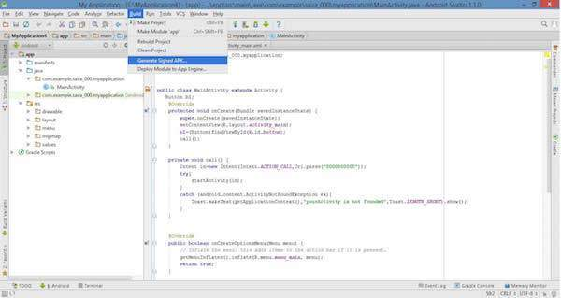
To export an application, just open that application project in Android studio and select Build → Generate Signed APK from your Android studio and follow the simple steps to export your application −

Slide 13
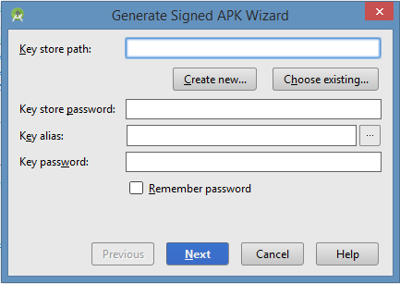
Next select, Generate Signed APK option as shown in the above screen shot and then click it so that you get following screen where you will choose Create new keystore to store your application.

Slide 14
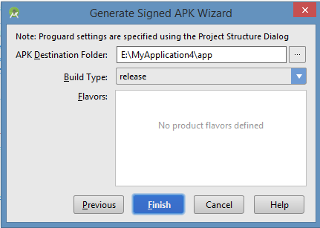
Enter your key store path,key store password,key alias and key password to protect your application and click on Next button once again. It will display following screen to let you create an application −

Slide 15
Once you filled up all the information,like app destination,build type and flavours click finish button While creating an application it will show as below
Finally, it will generate your Android Application as APK formate File which will be uploaded at Google Play marketplace.

